Slide 1
Course Outline
Goals and Preliminaries
Essential Python Modules for Machine Learning
A Gentle Introduction to Neural Networks
Building Neural Networks with Pytorch
Improving Neural Networks
Modern Practices
Capstone Project

Slide 2
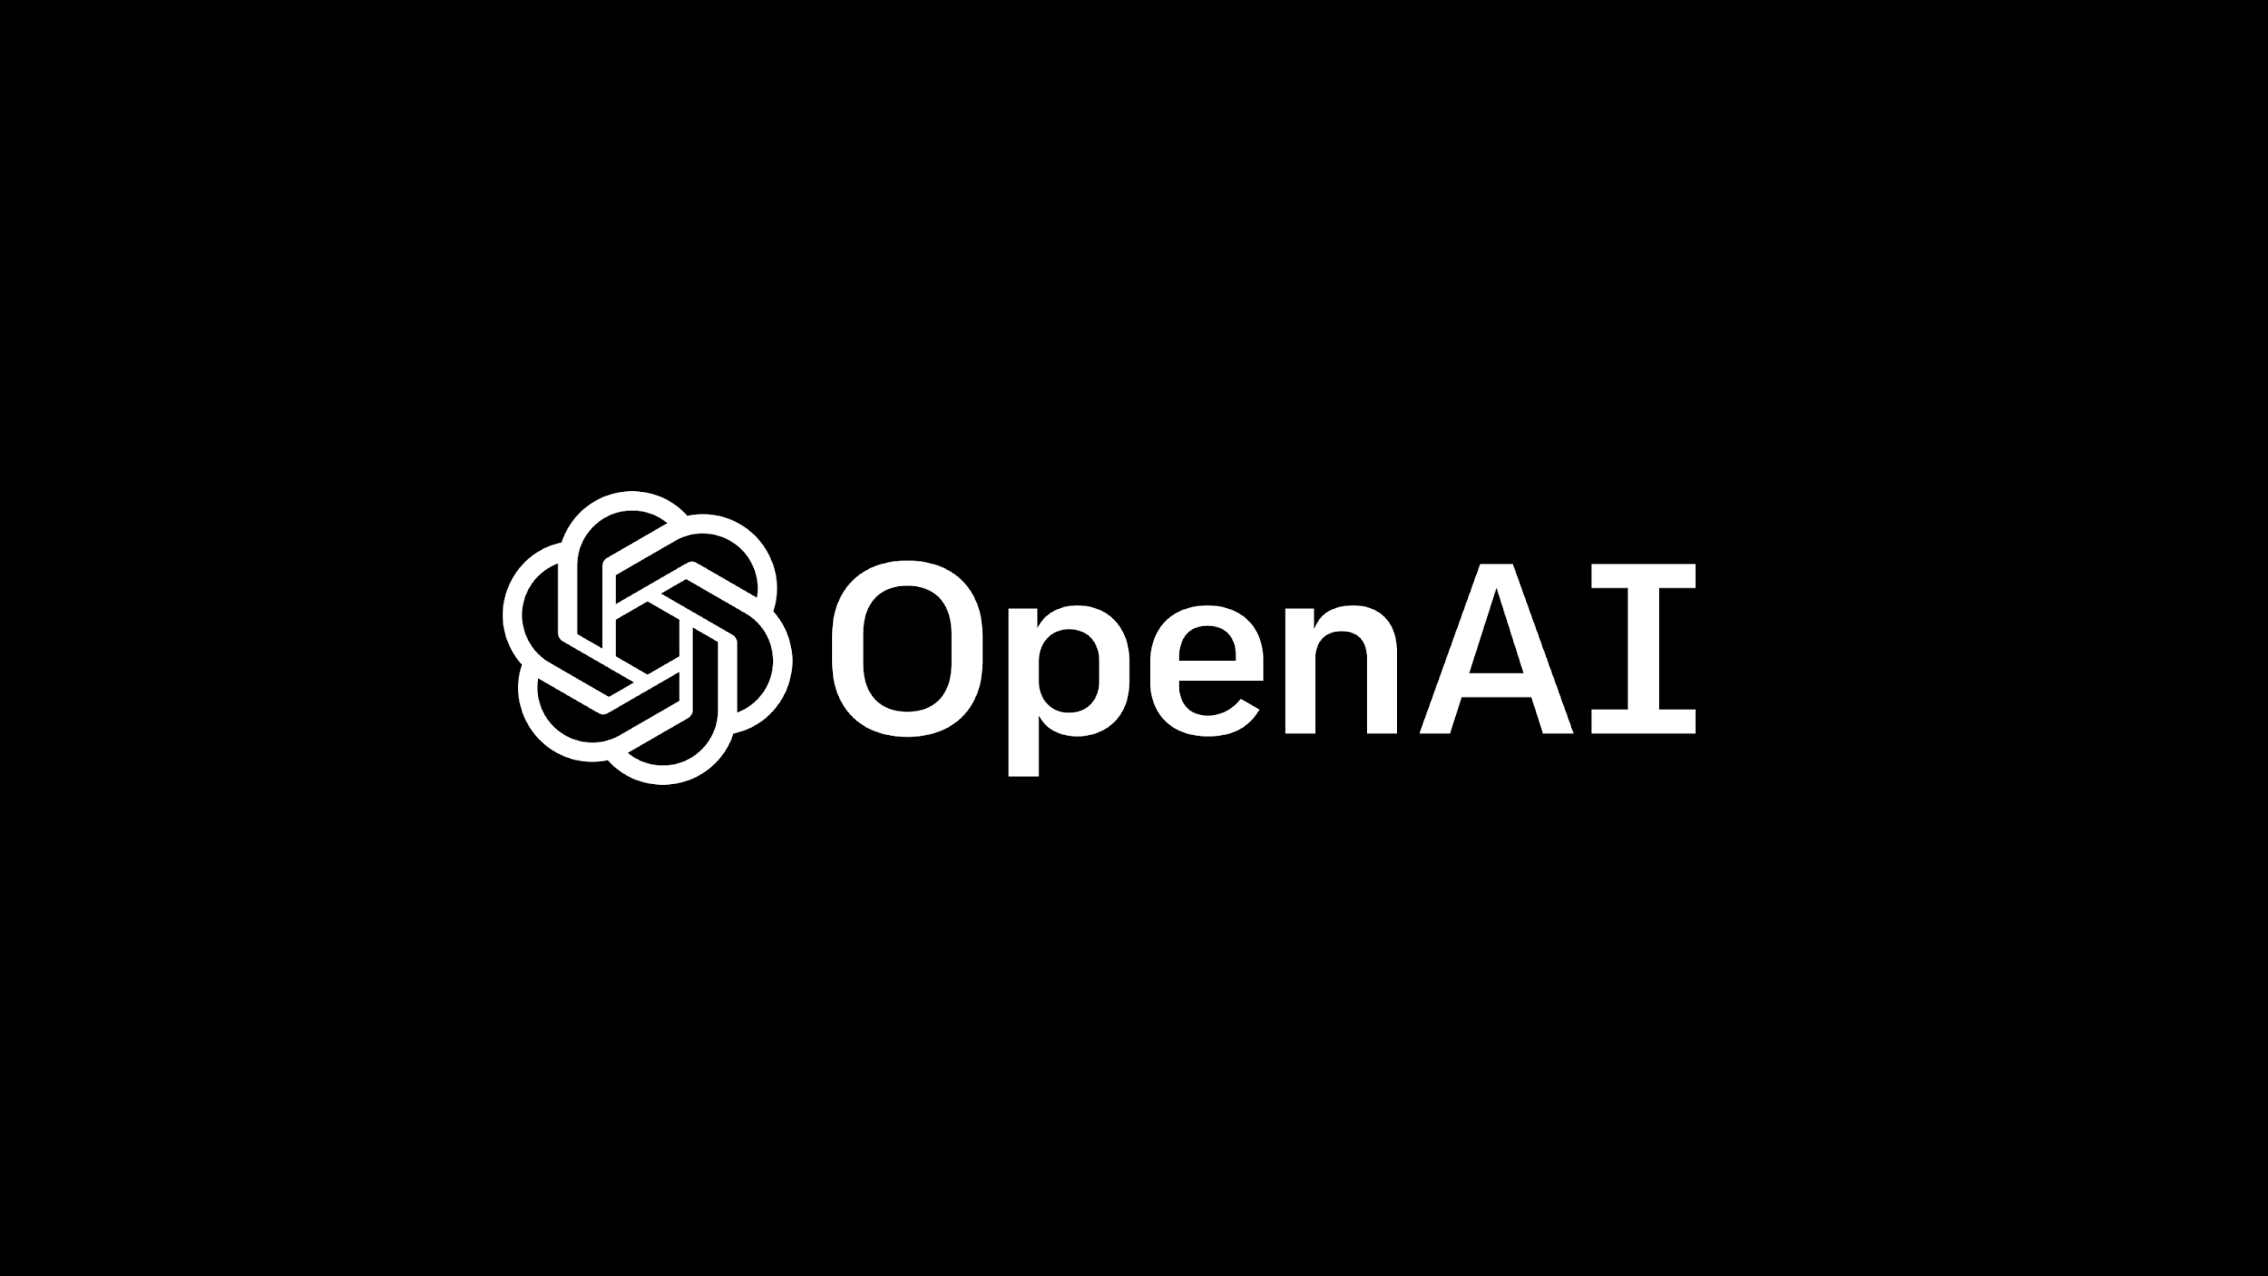




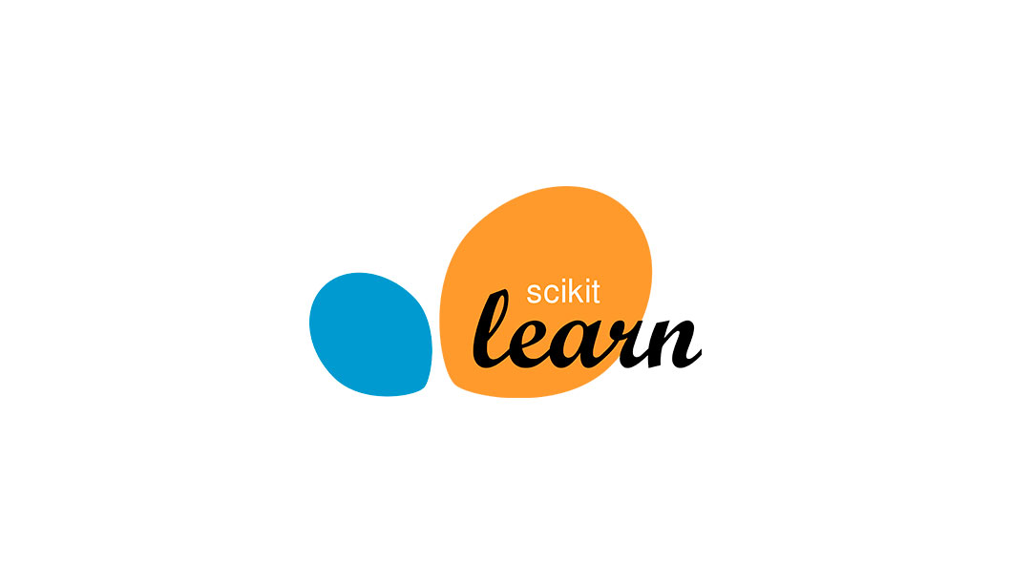








Slide 3
GOALS
General Principles
Learn how AI works in theory and practice.
Gain confidence in Python coding and AI tools.
Admire how Cal3 level math can shape the world!
Create realistic applications to solve a real-world problem.
Aim for internships and jobs in top companies and institutions doing AI research.
Try to keep up with the pace, do your best not to miss a single class.
No exams, just group assignments and projects.
Do not intimidated by the amount of scientific tools, you are not alone.
Presentation → Coding → Discussion

Slide 4
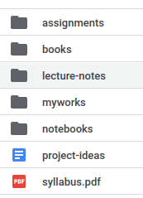
Technical Stuff
All lecture notes, codes and assignment will be posted on Google Colab.
Find your working body and signed a collaboration agreement and email it to me. You should do this before the next Monday.
Your group will have a link to your Colab space. Everything will be ready to run, no install required. The only rule is “do not delete any folder or change folder names”. Use “myworks” folder
You are welcome to install Python locally to your computer. Just follow the instruction in our syllabus. However, assignments must be submitted on Colab.
Our main communication tool is Slack. Post all technical questions there. I will also post all the stuff on Github.

Slide 5
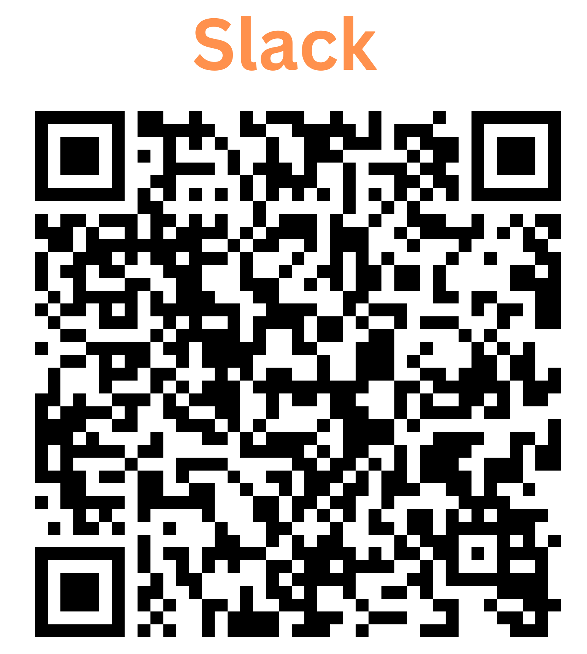
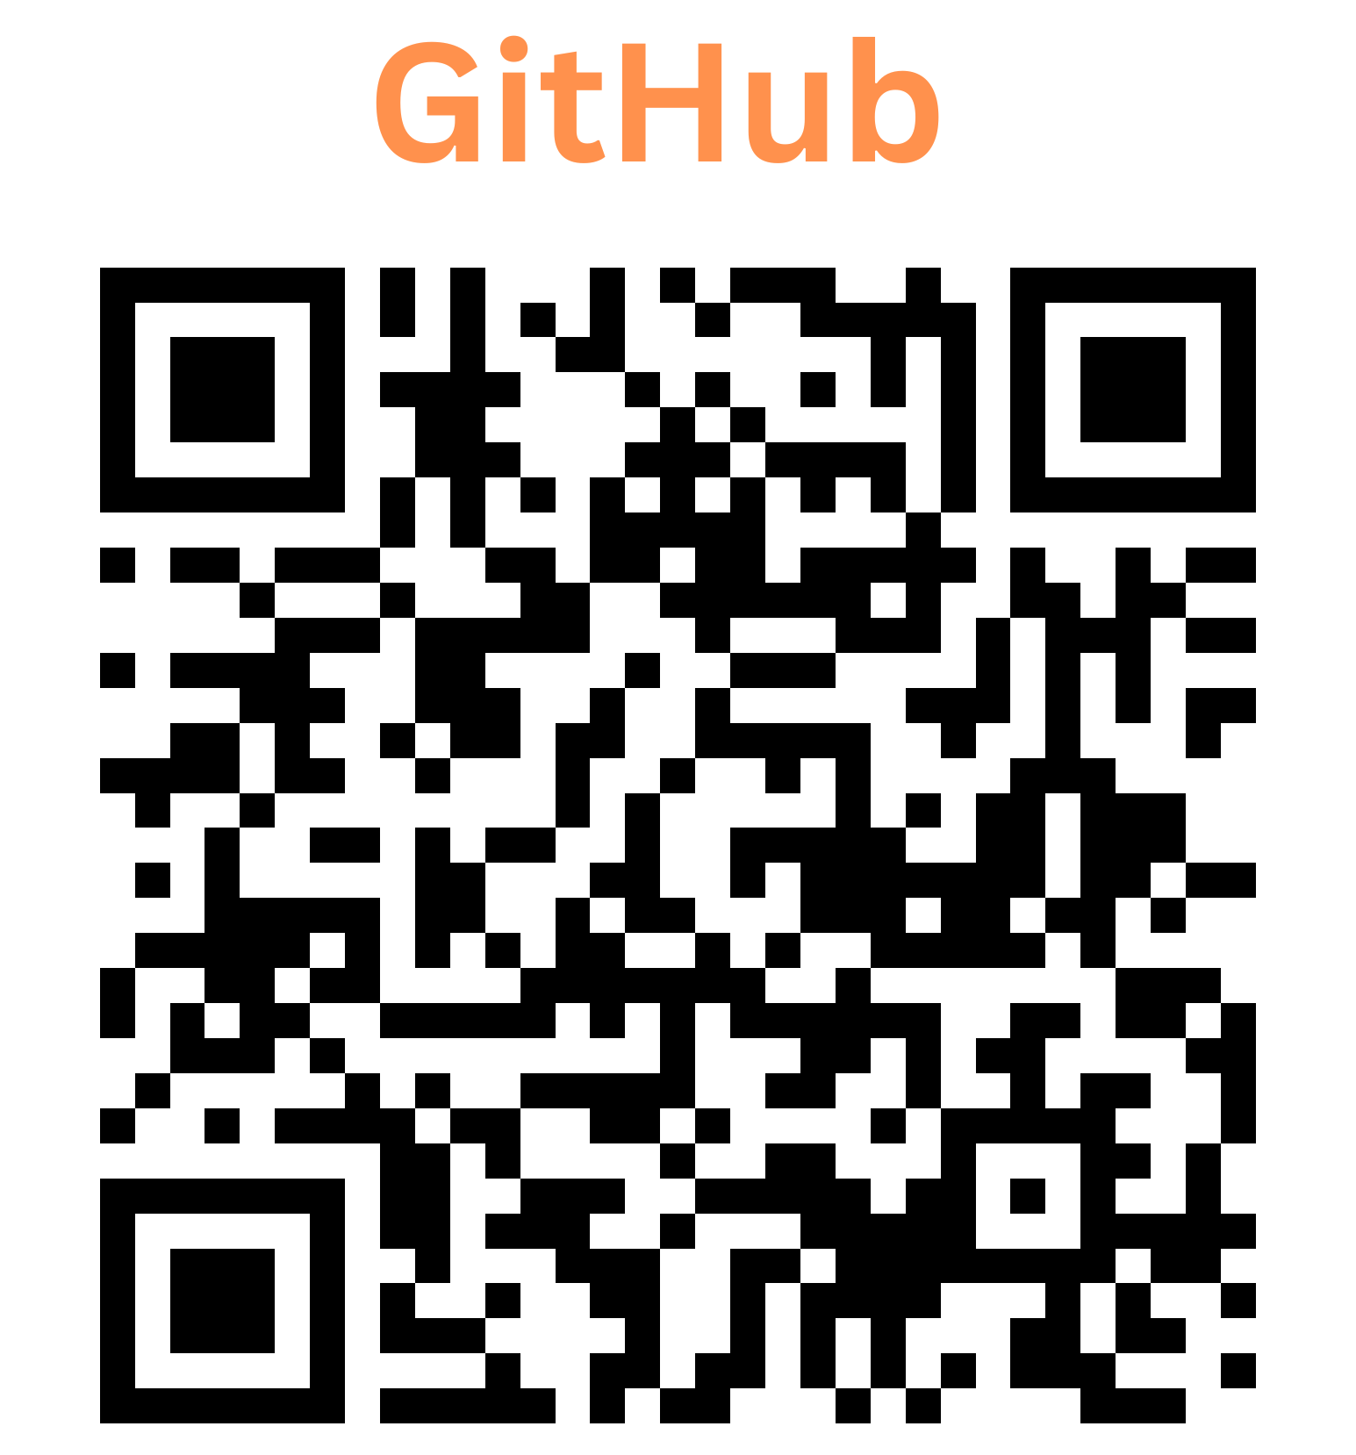

Slide 6
CH1: Essential Python Modules for Machine Learning
CH2: A Gentle Introduction to Neural Networks
Python Basics
Array Operations with Numpy
Data Visualization with Matplotlib
Data Manipulation with Pandas
Basics of Image Processing with PIL
Gradient Descent Algorithm
Linear Regression
From Linear Regression to Neural Networks
Backpropogation

Slide 7
CH3: Building Neural Networks with Pytorch
CH4: Improving Neural Networks
Introduction to Pytorch
Linear Regression with Pytorch
Feed Forward Neural Networks(FNNs)
Convolutional Neural Networks(CNNs)
Transfer Learning
Data Augmentation, Regularization, Ensembling
Hyperparameter Optimization

Slide 8
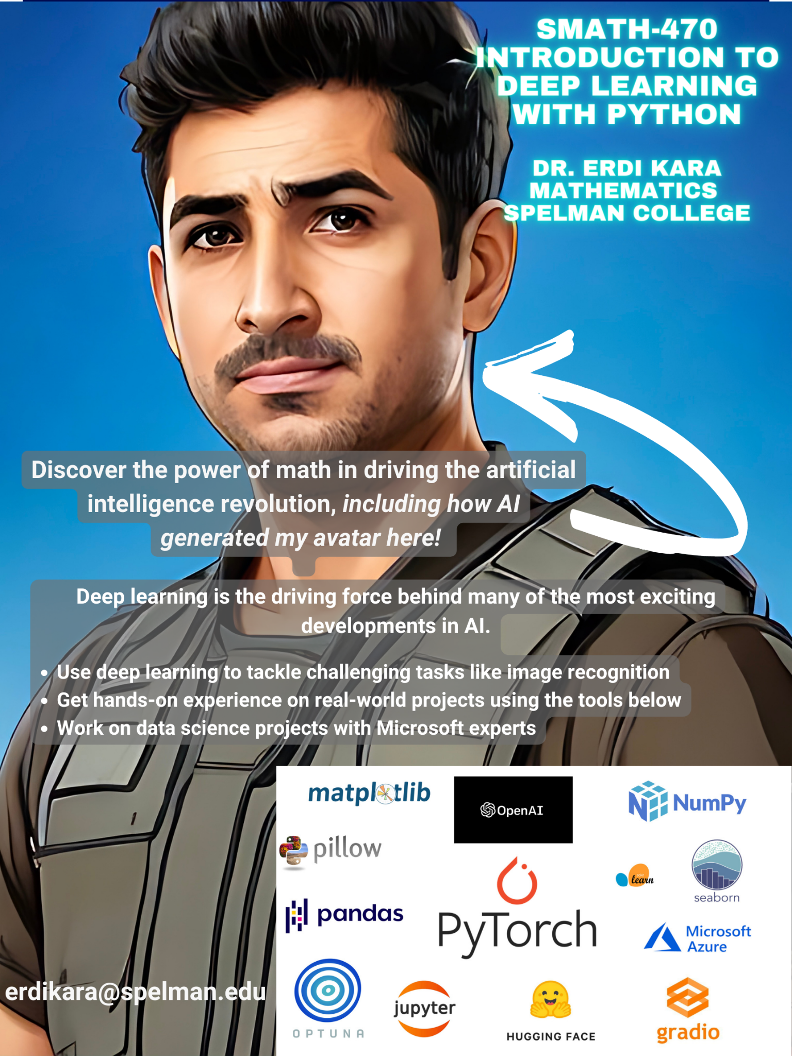
CH5: Modern Neural Network Architectures
Auto-Encoders, Generative Adversarial Networks, Transformers, Diffusion Models.
YOLO, GPT, Stable Diffusion, Whisper.
Introduction to HuggingFace domain.

Slide 9
CH5: Capstone Projects
Capstone Project-1
Although the course specifically focuses on image recognition, groups can pick up any neural network application that can be completed before the end of semester.
I will provide a set of potential applications but groups are encouraged to identify their own projects. Once the target problem is identified, we will create an end-to-end project pipeline and deploy our model publicly.
Look around for cool projects around deep learning applications in computer vision. We will gradually build your project in the semester, collect data, search the best model etc.
Capstone Project-2
Each group will be assigned to a data science expert from Microsoft. Under the supervision of the group mentor, groups will identify machine learning and data science related projects.
Group members should keep in mind their mentor is volunteering part of their precious time to help them. Therefore, it is important to respect your mentor’s time and efforts during the semester.
Group members should be committed to carry out the tasks such as collecting data, doing some research and preparing short presentations assigned by their mentor as part of their projects.

Slide 10
